Slide 1
CODATA-RDA Schools
Hugh.Shanahan@rhul.ac.uk
https://hughshanahan.github.io/CODATA-RDA-HIC

Slide 2
Competency centres
Provide materials
Get feedback from ESFRI’s
Conduit for reaching out to ESFRI’s for related schools
Trial and implement training through short courses
Modelled on successful CODATA-RDA School of Research Data Science
Scale through train-the-trainer activity

Slide 3
CODATA-RDA schools
Two week event
6 Schools since 2016
Run on three continents
~250 students from 40 countries
Clear track record of success
Focus on ECR’s from Low and
Middle Income Countries
Data Science skills
NOT another bootcamp!

Slide 4
Organisation
Volunteer network
Support from wide variety of institutions (see end)

Slide 5
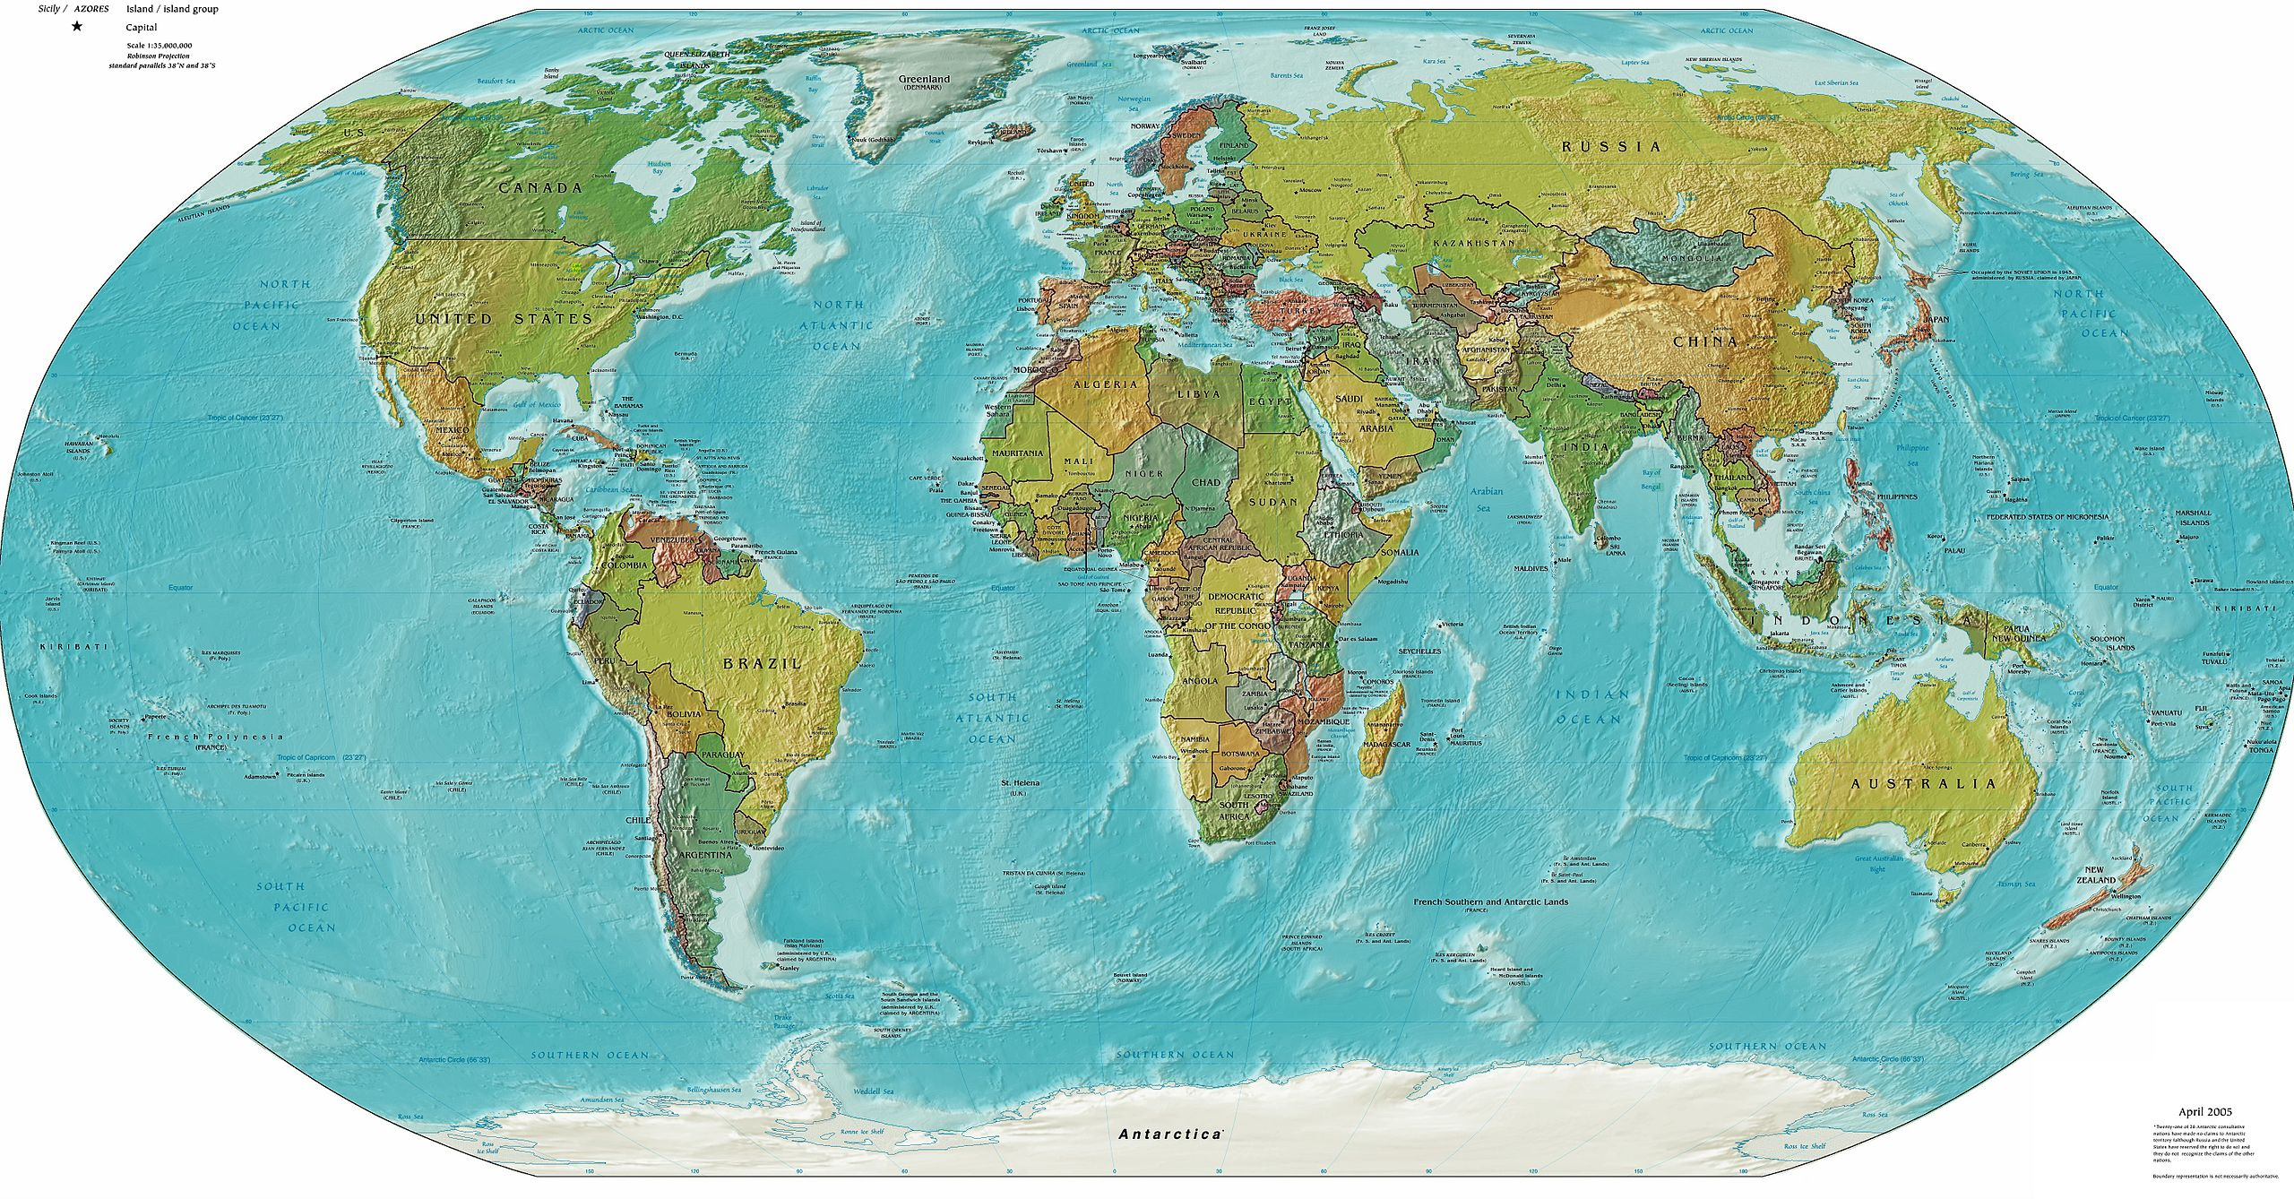
Trieste, Aug 2016
July 2017
Aug 2018
San José, Dec 2019
Aug 2019
Kigali, Oct 2018
Brisbane, Jun 2018
São Paulo Dec 2017
Dec 2018

Slide 6
Curriculum
Software Carpentry
Computational Infrastructures
Visualisation
Open Science
Research Data Management
Machine Learning
Author Carpentry
Information Security

Slide 7
FAIRsFAIR
New EU network
“FAIRsFAIR aims to supply practical solutions for the use of the FAIR data principles throughout the research data life cycle with emphasis on fostering FAIR data culture and the uptake of good practices in making data FAIR.”
Delivery of three CODATA-RDA schools for a European audience and greater FAIR data content.
Discussion of delivery of ‘franchised’ schools for
specific disciplines.

Slide 8
Pilot version (Trieste August 2019)
Data Science
Strand
Common
Data Steward
Strand
Week 1
Week 2

Slide 9


Full version - Q1 2020
Data Science
Strand
Additional
Data
Search
Data
From
Analysis
Meta-
Analysis
Common
Initial Data Set
Annotation
Data Steward
Strand
Week 1
Week 2
Speaking with other professional groups - DigCurv

Slide 10
Useful links
Schools home page
http://www.codata.org/working-groups/research-data-science-summer-schools
Github repository of materials
https://github.com/CODATA-RDA-DataScienceSchools/Materials
Github repository of further documentation
https://github.com/CODATA-RDA-DataScienceSchools/TaskGroup
Video of one of the schools
https://vimeo.com/299263596
FAIRsFAIR web site
https://www.fairsfair.eu/

Slide 11
Co-chairs
Louise Bezuidenhout, University of Oxford
Raphael Cobé, University of São Paulo
Marcela Alfaro Córdoba, Universidad de Costa Rica
Sarah Jones, Digital Curation Centre
Rob Quick, Indiana University
Hugh Shanahan, Royal Holloway, University of London
ICTP Local Organiser
Executive Director of CODATA
Clement Onime
Simon Hodson

Slide 12
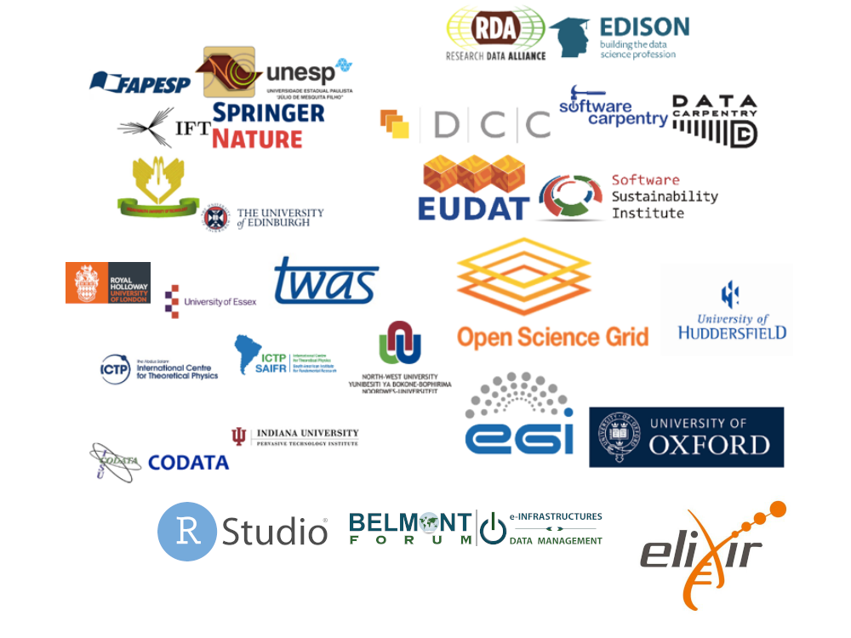
Our partners

Slide 13
Train trainers
Need to learn from others
Training in CODATA-RDA is based on shadowing
First approach - run TT in parallel with schools
Open to different approaches here

Slide 14
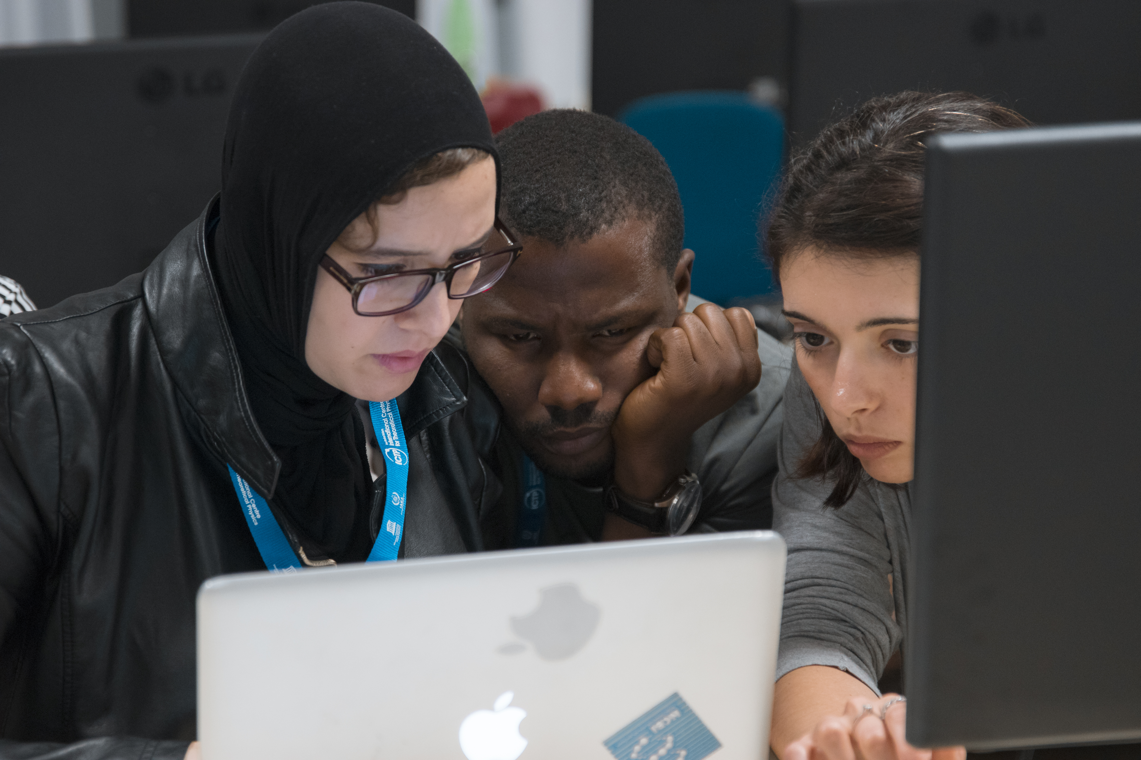
Remember
Most of all what’re doing here is
Changing a culture
Getting people to work together
Building communities that
follow an approach
That is really, really, hard.

Slide 15
Questions
Is the simulated model for week 2 reasonable?
Are there better concepts for Train Trainers?

